Slide 1

Blinky Workshop
BYUI Hackathon

Slide 2

Download and install the Arduino IDE
https://www.arduino.cc/en/software/

Slide 3
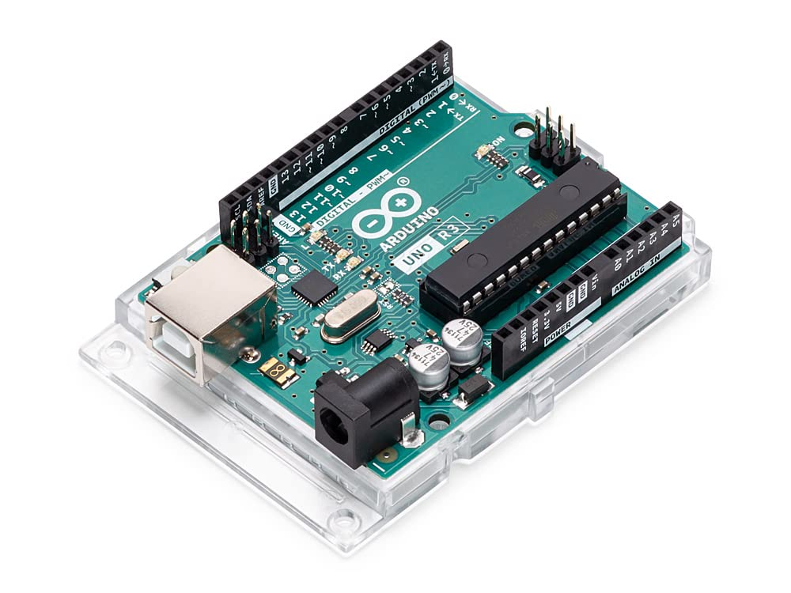
What is an Arduino?
A microcontroller that:
Can send and receive electrical signals
Can be programmed (using Arduino IDE)
Uses its programming and input/output ports to make an embedded system that interfaces with the real world

Slide 4
What We’re Doing Today
In this workshop, we will make a “blinky” that flashes a light. We will need to:
Wire up an electrical circuit
Connect the circuit to the Arduino externally (wires) and internally (code)
Write the program to control the Arduino (C++ Language)
Run it

Slide 5
But First, A Little About Electricity
Electricity is defined as the flow of electrons through a wire that powers machines and sends signals
Electricity can be dangerous, but at this level it’s weak enough to be harmless
HOWEVER: If a circuit is wired incorrectly, it CAN harm your equipment
It has numerical properties which need to be balanced across a circuit, and are represented by mathematical variables and equations

Slide 6
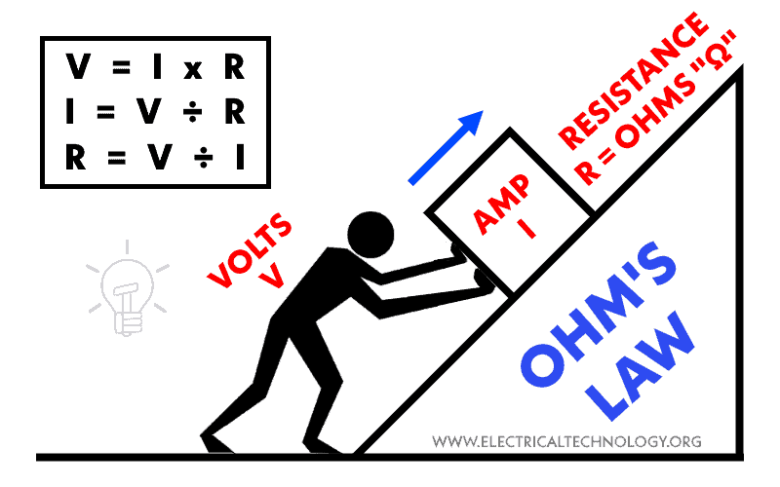
Ohm’s Law
Basic components of electricity:
Voltage: electrical potential, the “push” of flow
Current: the rate of flow
Resistance: the opposition to current flow
V = I * R
We aren’t going to calculate anything today, but this
essential for making your own circuits

Slide 7
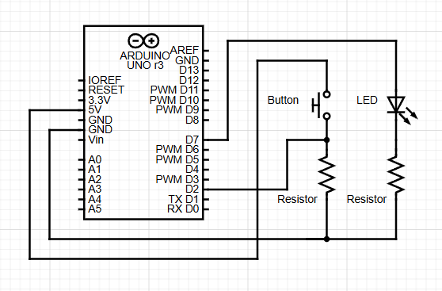
The Circuit Diagram
This is the diagram for electrical connectivity.

Slide 8
What You Need
1x Arduino Uno w/ USB cable
1x Breadboard
1x Push Button
1x LED
2x Resistors
4+ Jumper Wires

Slide 9
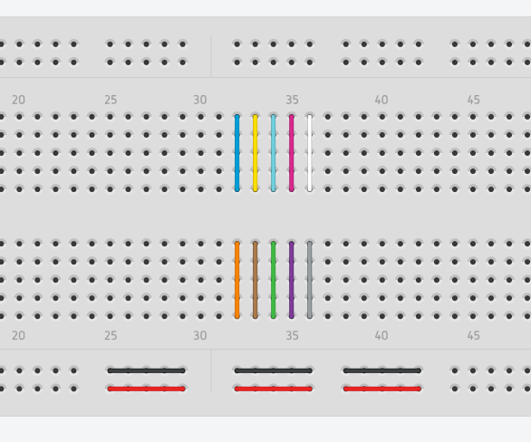
Breadboards
Give a solid foundation for wire connections
Internal Connectivity
Horizontal rows (top/bottom of board)
Each individual column (connection doesn’t span gap)

Slide 10
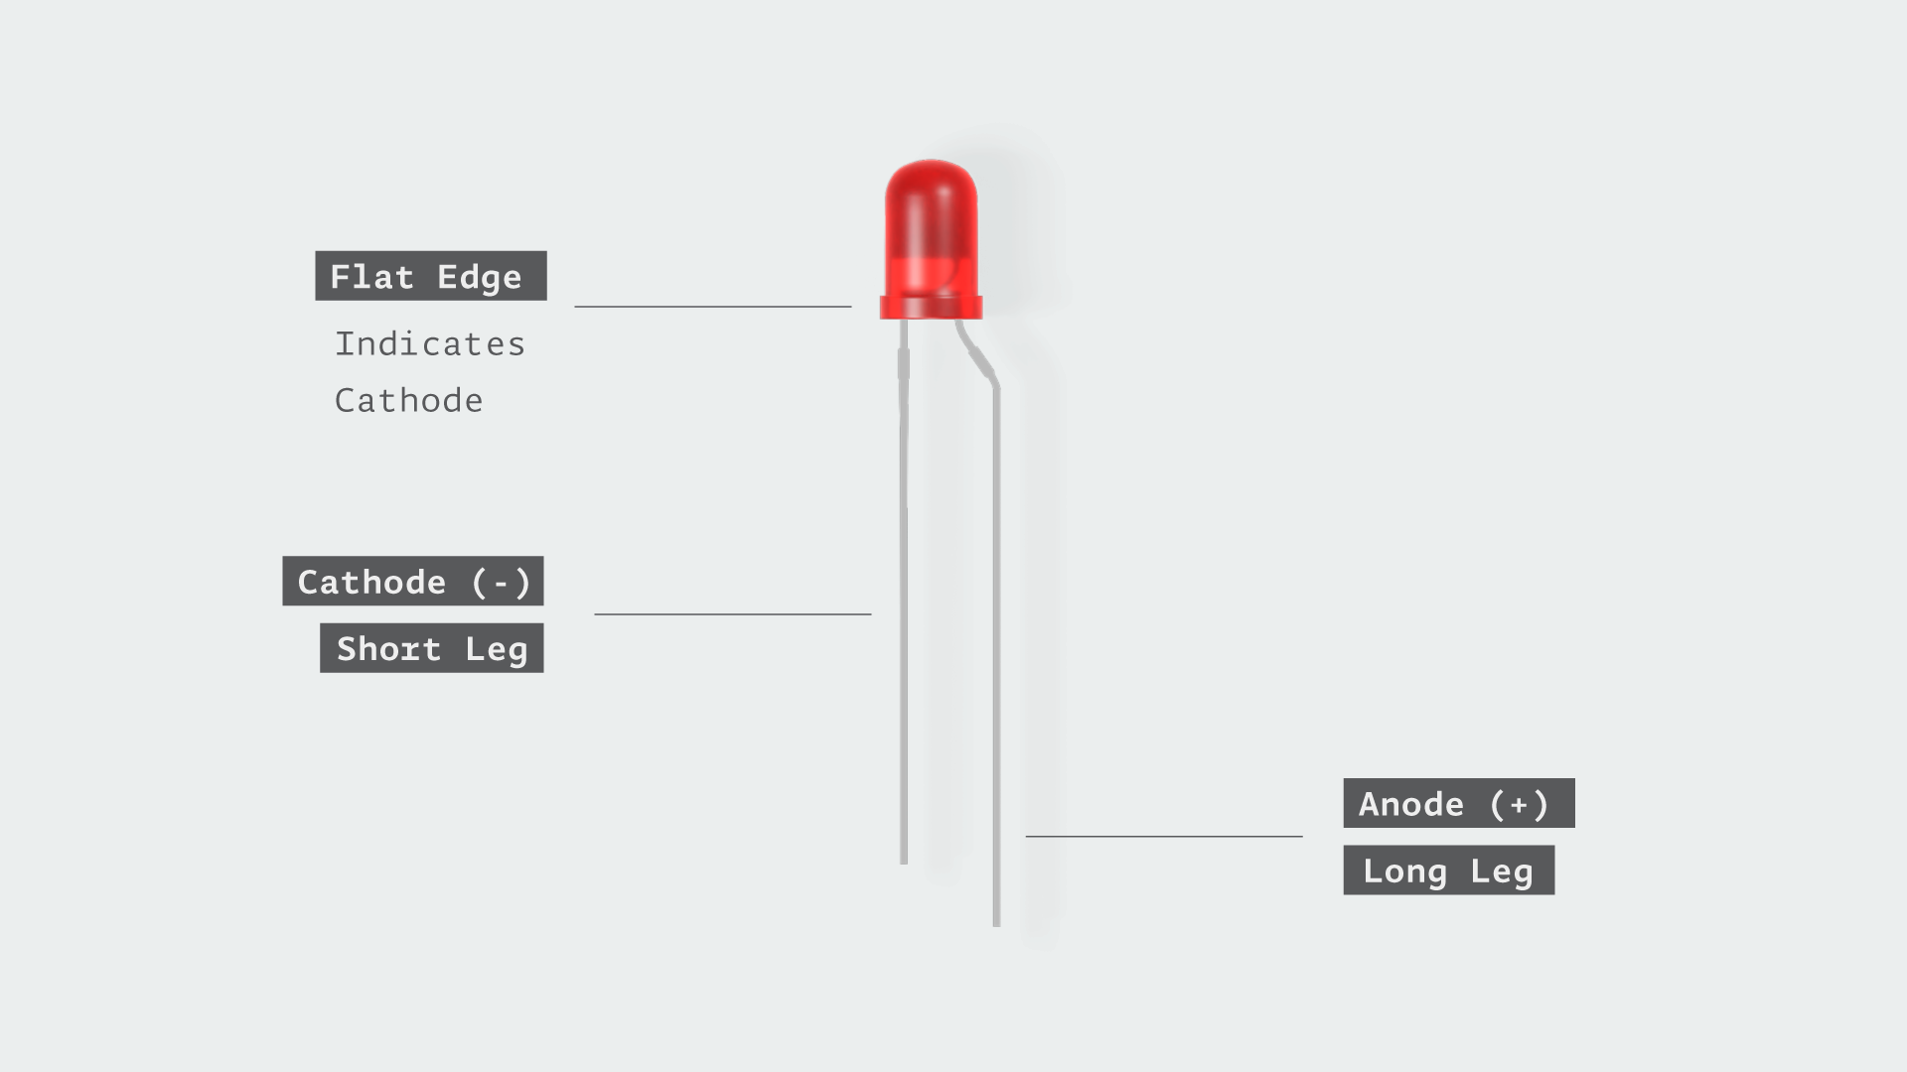
LED Orientation
LEDs are designed to take current flow from one direction. Pay attention to the legs!

Slide 11
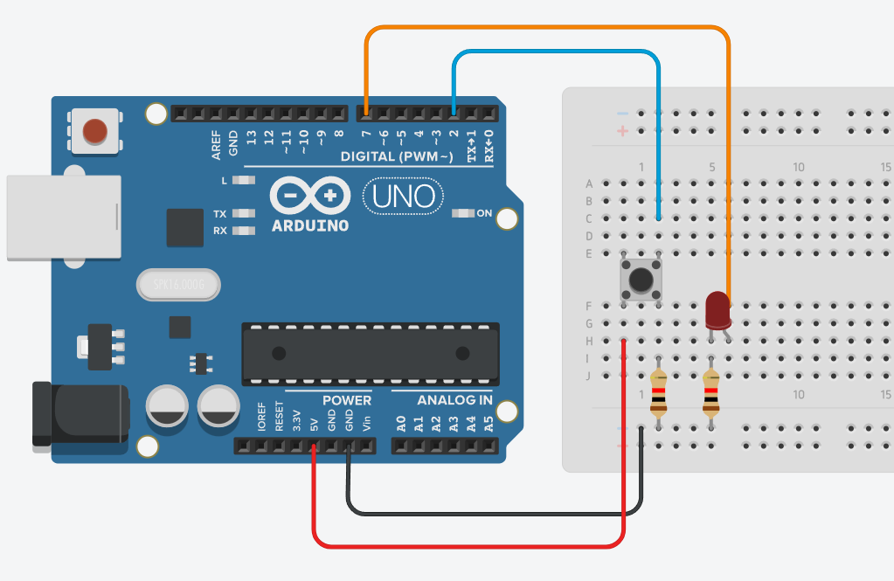
Wire Up Your Board

Slide 12
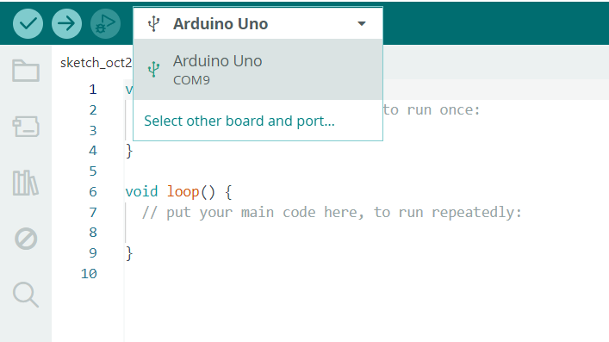
It Doesn’t Do Anything…Yet
Open up Arduino IDE and create a new sketch. This is the script that we will send to our Arduino to control our circuit.
Plug in your Arduino and select it in the device selector. It will be on one of your COM ports which connect to your USB devices.

Slide 13
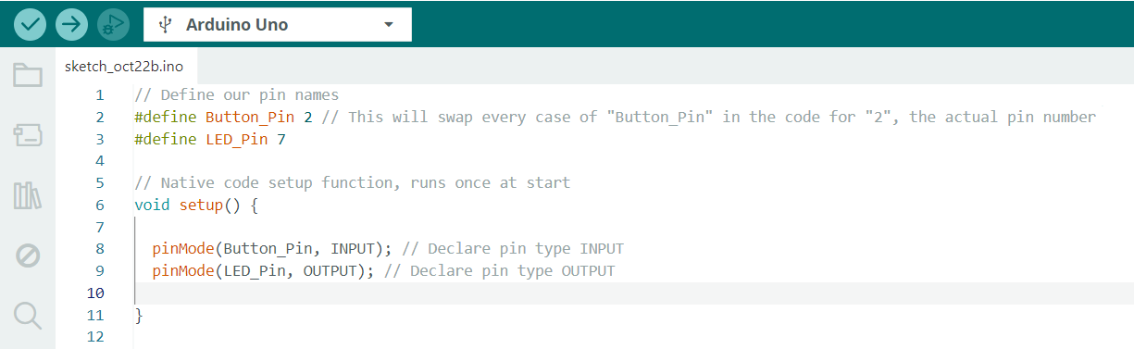
Define Your Input/Output Pins
The Arduino can’t manipulate any of the electrical pins yet. We need to define them as inputs (things to read) or outputs (things to write to). Follow along with the code below:

Slide 14
The Logic Flow
Start
Our goal is to make our circuit enter different “modes.” We want a state where the LED is turned off, a state where the LED is blinking, and a state where the LED is flashing.
We are going to make a state machine, a circuit that has different “tasks” that it can switch between.
LED OFF
Button Press
Button Press
LED FLASHING
LED BLINKING
Button Press

Slide 15
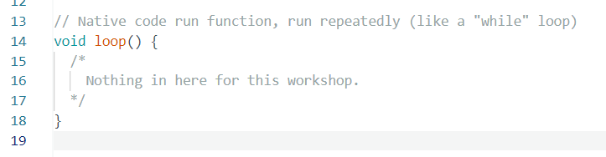
Loops
Normally the project code is put into the default loop that runs forever. Instead, we are going to make a function for every state and runs loops inside them.
When we want to change the state, we will break the loop and finish the rest of the function, which calls the next state in line. We will use a global variable for this. Below your define statements, add:

Slide 16
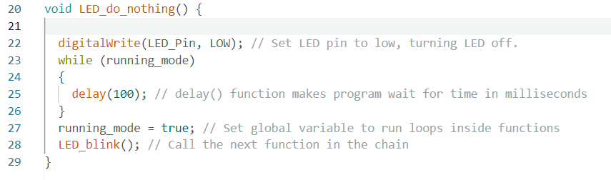
Function: LED_do_nothing()
Copy the following function below the main loop:
digitalWrite(): Sets an output pin to HIGH or LOW, a logical 1 or 0. This turns on/off our LED.
delay(): Makes the program wait for a time in milliseconds.

Slide 17
Interrupts
But wait? How is “running_mode” supposed to change if the program is stuck inside the while() loop?
Many programs need to be able to execute changes instantly without waiting for current processes to finish. These “instant” executions are called interrupts.
The Arduino has the ability to “pause” what it’s doing in order to handle these important tasks when they come up, and then go back to what it was doing before.

Slide 18
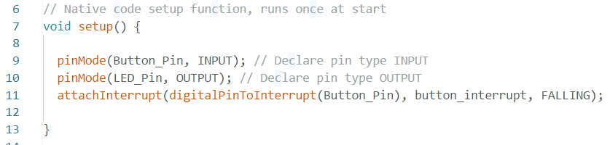
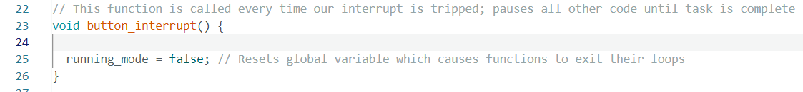
Add the Interrupt and its Logic
Add in setup():
Add below loop():

Slide 19
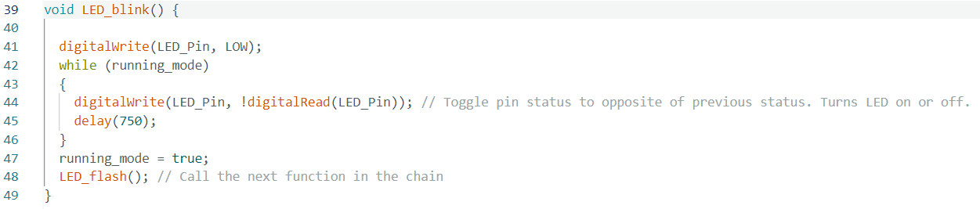
Function: LED_blink()
Add below LED_do_nothing():

Slide 20
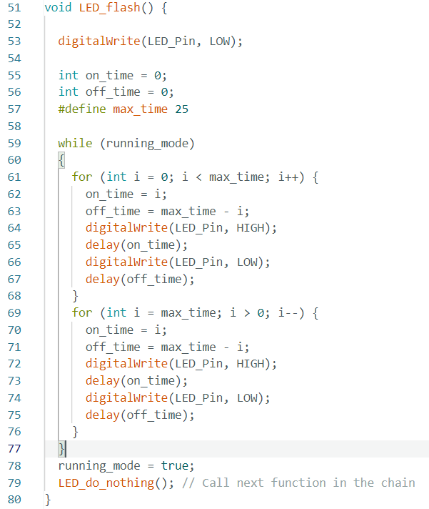
Function: LED_flash()
Add below LED_blink():
This function is a more complicated version of LED_blink(), stepping the delay times up and down to make the light appear to be getting brighter and dimmer.

Slide 21
Serial Monitor
When debugging, it’s helpful to be able to see your data. Arduino IDE has a serial monitor terminal for this. We can add print() statements to our program to see where our CPU is in the code even if the circuit isn’t working the way we want it to.
Add in setup():
Add to the start of each of your functions (change what it says for each one):
And finally, start the first function at the end of setup():

Slide 22

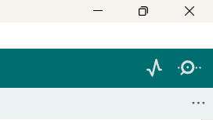
Verify and Upload Your Sketch
Click check mark to verify your code, then upload it once it’s error-free.
Press the button on the breadboard to cycle between the LED states.
Click the magnifying glass icon in your IDE to see your print() statements the serial monitor.
Make your own custom LED state!

Slide 23
Questions
1) What are the limitations of this program? How could it be done more efficiently?
2) In the serial monitor, you might see the "Button press detected" message appear multiple times with every button press. Why is this happening? How could it be fixed?
3) In the circuit, why is there a resistor that attaches the button output to ground?
- LED "flash" stuttering is noticeable (not true pulse-width modulation).
- "running_mode" exits the loop inside the function AFTER it finishes; it doesn't switch right away like an interrupt normally would.
- The button is actually bouncing up and down, and the sensitive voltage spikes are
being picked up. Need to enable "debouncing" in either the hardware or software.
- “Pull-down” resistor stabilizes the voltage when the button isn’t being pressed, so it doesn’t read “nothing” and give bad values

Slide 24
Thanks For Coming

